Slide 1
White Box Testing
Notes:
Workshop on "How to find software faults before our customers find them" Copyright©2007

Slide 2
White Box Testing
Definition
White box testing is a strategy in which testing is based on the internal paths, structure, and implementation of the software under test (SUT).
Unlike its complement, black box testing, white box testing generally requires programming skills.
Notes:
Workshop on "How to find software faults before our customers find them" Copyright©2007

Slide 3
White Box Testing
The general white box testing process is:
The SUT’s implementation is analyzed.
Paths through the SUT are identified.
Inputs are chosen to cause the SUT to execute selected paths. This is called path sensitization. Expected results for those inputs are determined.
The tests are run.
Actual outputs are compared with the expected outputs.
A determination is made as to the proper functioning of the SUT.
Notes:
Workshop on "How to find software faults before our customers find them" Copyright©2007

Slide 4
White Box Testing
Applicability
White box testing can be applied at all levels of system development-unit, integration, and system.
White box testing is more than code testing-it is path testing.
Generally, the paths that are tested are within a module (unit testing).
But we can apply the same techniques to test paths between modules within subsystems, between subsystems within system, and even between entire systems.
Notes:
Workshop on "How to find software faults before our customers find them" Copyright©2007

Slide 5
White Box Testing : Disadvantages
The number of execution paths may be so large that they cannot all be tested. Testing all execution paths through white box testing is generally as infeasible as testing all input data combinations through black box testing.
The test cases chosen may not detect data sensitivity errors. For example:
p=q/r;
may execute correctly except when r=0.
y=2*x // should read y=x²
will pass for test cases x=0, y=0 and x=2, y=4
Notes:
Workshop on "How to find software faults before our customers find them" Copyright©2007

Slide 6
White Box Testing - Disadvantage
White box testing assumes the control flow is correct (or very close to correct). Since the tests are based on the existing paths, nonexistent paths cannot be discovered through white box testing.
The tester must have the programming skills to understand and evaluate the software under test.
Notes:
Workshop on "How to find software faults before our customers find them" Copyright©2007

Slide 7
White Box Testing - Advantage
Advantage
When using white box testing, the tester can be sure that every path through the software under test has been identified and tested.
Notes:
Workshop on "How to find software faults before our customers find them" Copyright©2007

Slide 8

Graph Theory
Technique
Control Flow Graphs
Control flow graphs are the foundation of control flow testing. These graphs document the module's control structure.
The paths through the graphs are analyzed, and test cases are created from that analysis.
Notes:
Workshop on "How to find software faults before our customers find them" Copyright©2007

Slide 9

Graph Theory
Process Blocks
A process block is a sequence of program statements that execute sequentially from beginning to end.
No entry into the block is permitted except at the beginning.
No exit from the block is permitted except at the end.
Once the block is initiated, every statement within it will be executed sequentially.
Process blocks are represented in control flow graphs by a bubble with one entry and one exit.
Notes:
Workshop on "How to find software faults before our customers find them" Copyright©2007

Slide 10
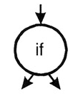

Graph Theory
Decision Point
A decision point is a point in the module at which the control flow can change.
Most decision points are binary and are implemented by if-then-else statements.
Multi-way decision points are implemented by case statements.
They are represented by a bubble with one entry and multiple exits.
Notes:
Workshop on "How to find software faults before our customers find them" Copyright©2007

Slide 11

Graph Theory
Junction Point
A junction point is a point at which control flows join together.
Notes:
Workshop on "How to find software faults before our customers find them" Copyright©2007

Slide 12
1 | void main()
2 | {
3 | float A,B,C;
4 | clrscr();
5 | printf("Enter number 1:\n");
6 | scanf("%f", &A);
7 | printf("Enter number 2:\n");
8 | scanf("%f", &B);
9 | printf("Enter number 3:\n");
10 | scanf("%f", &C);
11 | if(A>B) {
12 | if(A>C) {
13 | printf("The largest number is: %f\n",A);
14 | }
15 | else {
16 | printf("The largest number is: %f\n",C);
17 | }
18 | }
19 | else {
20 | if(C>B) {
21 | printf("The largest number is: %f\n",C);
22 | }
23 | else {
24 | printf("The largest number is: %f\n",B);
25 | }
26 | }
27 | getch();
28 | }

Slide 13
Structured Testing / Basis Path Testing
1
2
3
4
5
6
7
8
9
10
11
12
19
13
15
20
14
16
21
23
17
22
24
18
25
27
26
28
Control Flow Graph

Slide 14
Structured Testing / Basis Path Testing
DD Path Graph
It is an extension of the control flow graph.
In DD path graph, the nodes which are in sequence are combined into a single node and concentration is only on decision nodes.
Notes:
Workshop on "How to find software faults before our customers find them" Copyright©2007

Slide 15
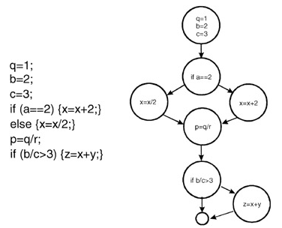
Structured Testing / Basis Path Testing
The following code example is represented by its associated flow graph:
Fig. 2: Flow graph equivalent of program code.
Notes:
Workshop on "How to find software faults before our customers find them" Copyright©2007

Slide 16
Program graph nodes | DD path graph corresponding node | Remarks
1 | S | Source node
2 to 10 | N1 | Sequential nodes, there is a sequential flow from node 2 to 10
11 | N2 | Decision node, if true goto 12, else goto 19
12 | N3 | Decision node, if true goto 13 else goto 15
13, 14 | N4 | Sequential nodes
15, 16, 17 | N5 | Sequential nodes
18 | N6 | Junction node, two edges 14 and 17 are terminated here
19 | N7 | Intermediate node terminated at node 20
20 | N8 | Decision node, if true goto 21 else goto 23
21, 22 | N9 | Sequential nodes
23, 24, 25 | N10 | Sequential nodes
26 | N11 | Junction node, two edges 22 and 25 are terminated here
27 | N12 | Junction node, two edges 18 and 26 are terminated here
28 | D | Destination node

Slide 17
Structured Testing / Basis Path Testing
N1
N2
N3
N7
N4
N5
N8
N6
N9
N10
N11
DD Path Graph for program to find the largest of amongst three numbers
N12
N13

Slide 18
Structured Testing / Basis Path Testing
Structured testing is based on the pioneering work of Tom McCabe. It uses an analysis of the topology of the control flow graph to identify test cases.
The structured testing process consists of the following steps:
Derive the control flow graph from the software module.
Compute the graph's Cyclomatic Complexity (C).
Select a set of C basis paths.
Create a test case for each basis path.
Execute these tests.
Notes:
Workshop on "How to find software faults before our customers find them" Copyright©2007

Slide 19
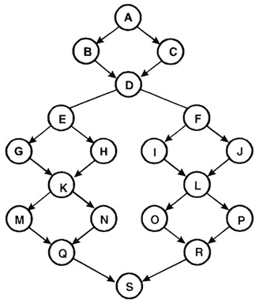
Structured Testing / Basis Path Testing
Consider the following control flow graph:
Fig. 8: An example control flow graph.
Notes:
Workshop on "How to find software faults before our customers find them" Copyright©2007

Slide 20
Structured Testing / Basis Path Testing
McCabe defines the Cyclomatic Complexity (C) of a graph as
C = edges - nodes + 2P
Edges are the arrows, and nodes are the bubbles on the graph, P are the connected components.
Here, edges=24, nodes=19, cyclomatic complex= 24-19+2=7
In some cases this computation can be simplified. If all decisions in the graph are binary (they have exactly two edges flowing out), and there are p binary decisions, then
C = p+1
Notes:
Workshop on "How to find software faults before our customers find them" Copyright©2007

Slide 21

Software Testing
Two alternate methods are available for the complexity calculations.
Cyclomatic complexity V(G) of a flow graph G is equal to the number of predicate (decision) nodes plus one.
V(G)= +1
Where is the number of predicate nodes contained in the flow graph G.
Cyclomatic complexity is equal to the number of regions of the flow graph.

Slide 22
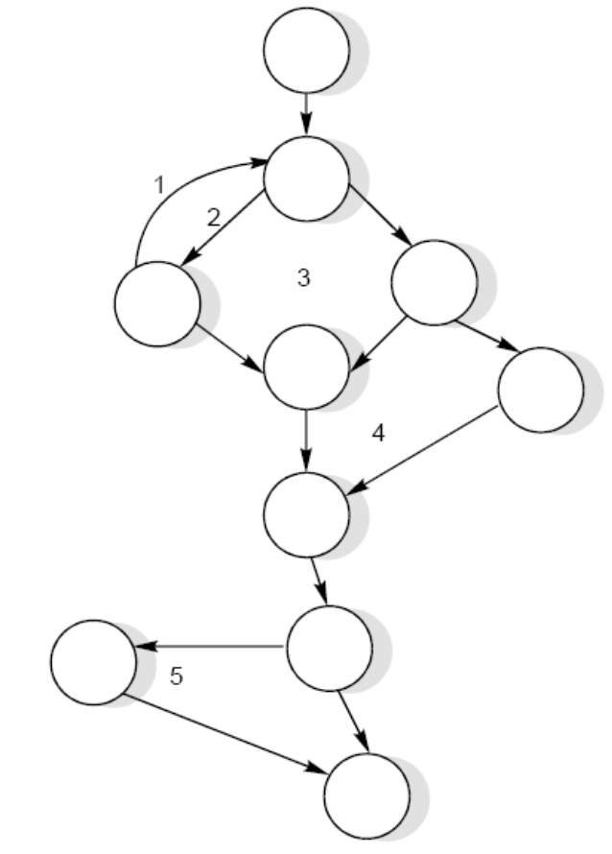
Software Testing
Example 8.15
Consider a flow graph given in Fig. and calculate the cyclomatic complexity by all three methods.

Slide 23
Software Testing
Solution
Cyclomatic complexity can be calculated by any of the three methods.
V(G) = e – n + 2P
  = 13 – 10 + 2 = 5
2. V(G) = π + 1
  = 4 + 1 = 5
3. V(G) = number of regions
  = 5
Therefore, complexity value of a flow graph in Fig. 23 is 5.

Slide 24
Structured Testing / Basis Path Testing
Cyclomatic Complexity is exactly the minimum number of independent, nonlooping paths (called basis paths) that can, in linear combination, generate all possible paths through the module.
In terms of a flow graph, each basis path traverses at least one edge that no other path does.
McCabe's structured testing technique calls for creating C test cases, one for each basis path.
Important: Creating and executing C test cases, based on the basis paths, guarantees both branch and statement coverage.
Notes:
Workshop on "How to find software faults before our customers find them" Copyright©2007

Slide 25
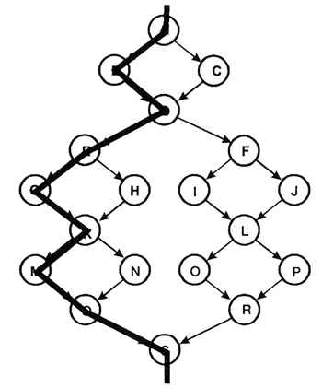
Structured Testing / Basis Path Testing
A process for creating a set of basis paths is given by McCabe:
Pick a "baseline" path. This path should be a reasonably "typical" path of execution rather than an exception processing path. The best choice would be the most important path from the tester's view.
Fig. 9: The chosen baseline basis path ABDEGKMQS
Notes:
Workshop on "How to find software faults before our customers find them" Copyright©2007

Slide 26
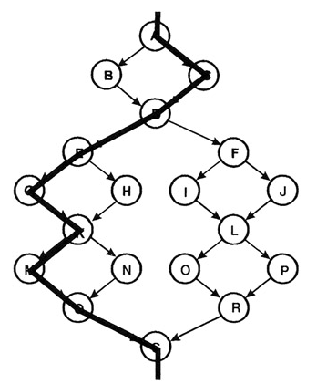
Structured Testing / Basis Path Testing
2. To choose the next path, change the outcome of the first decision along the baseline path while keeping the maximum number of other decisions the same as the baseline path.
Fig. 10: The second basis path ACDEGKMQS
Notes:
Workshop on "How to find software faults before our customers find them" Copyright©2007

Slide 27
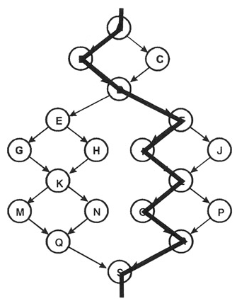
Structured Testing / Basis Path Testing
3. To generate the third path, begin again with the baseline but vary the second decision rather than the first.
Fig.11: The third basis path ABDFILORS
Notes:
Workshop on "How to find software faults before our customers find them" Copyright©2007

Slide 28
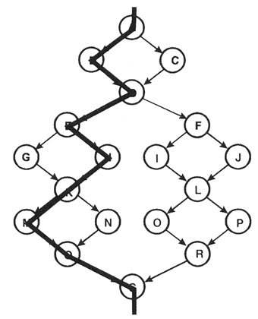
Structured Testing / Basis Path Testing
4. To generate the fourth path, begin again with the baseline but vary the third decision rather than the second. Continue varying each decision, one by one, until the bottom of the graph is reached.
Fig.12: The fourth basis path ABDEHKMQS
Notes:
Workshop on "How to find software faults before our customers find them" Copyright©2007

Slide 29
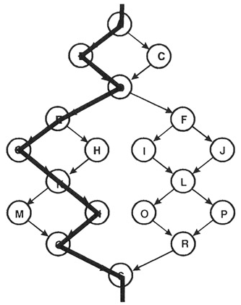
Structured Testing / Basis Path Testing
Fig.13: The fifth basis path ABDEGKNQS
Notes:
Workshop on "How to find software faults before our customers find them" Copyright©2007

Slide 30
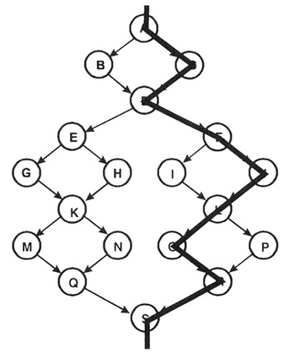
Structured Testing / Basis Path Testing
5. Now that all decisions along the baseline path have been flipped, we proceed to the second path, flipping its decisions, one by one. This pattern is continued until the basis path set is complete.
Fig.14: The sixth basis path ACDFJLORS
Notes:
Workshop on "How to find software faults before our customers find them" Copyright©2007

Slide 31
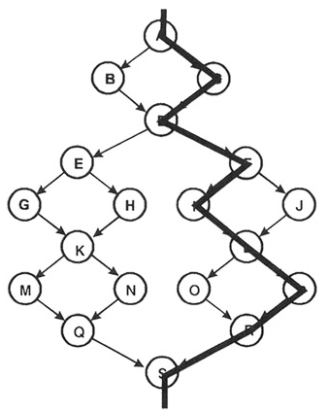
Structured Testing / Basis Path Testing
Fig.15: The seventh basis path ACDFILPRS
Notes:
Workshop on "How to find software faults before our customers find them" Copyright©2007

Slide 32
Structured Testing / Basis Path Testing
Thus, a set of basis paths for this graph are:
ABDEGKMQS
ACDEGKMQS
ABDFILORS
ABDEHKMQS
ABDEGKNQS
ACDFJLORS
ACDFILPRS
Notes:
Workshop on "How to find software faults before our customers find them" Copyright©2007

Slide 33
Structured Testing / Basis Path Testing
Structured testing calls for the creation of a test case for each of these paths. This set of test cases will guarantee both statement and branch coverage.
Note that multiple sets of basis paths can be created that are not necessarily unique. Each set, however, has the property that a set of test cases based on it will execute every statement and every branch.
Notes:
Workshop on "How to find software faults before our customers find them" Copyright©2007

Slide 34
Software Testing
Example 1:
Consider the given program of the determination of the nature of roots of a quadratic equation. Its input is a triple of positive integers (say a,b,c) and values for each of these may be from interval [0,100]. The output may have one of the option given below:
  Not a quadratic program
  real roots
  imaginary roots
  equal roots
  invalid inputs
Draw control flow graph, DD path graph and find cyclomatic complexity.
Notes:
Workshop on "How to find software faults before our customers find them" Copyright©2007

Slide 35
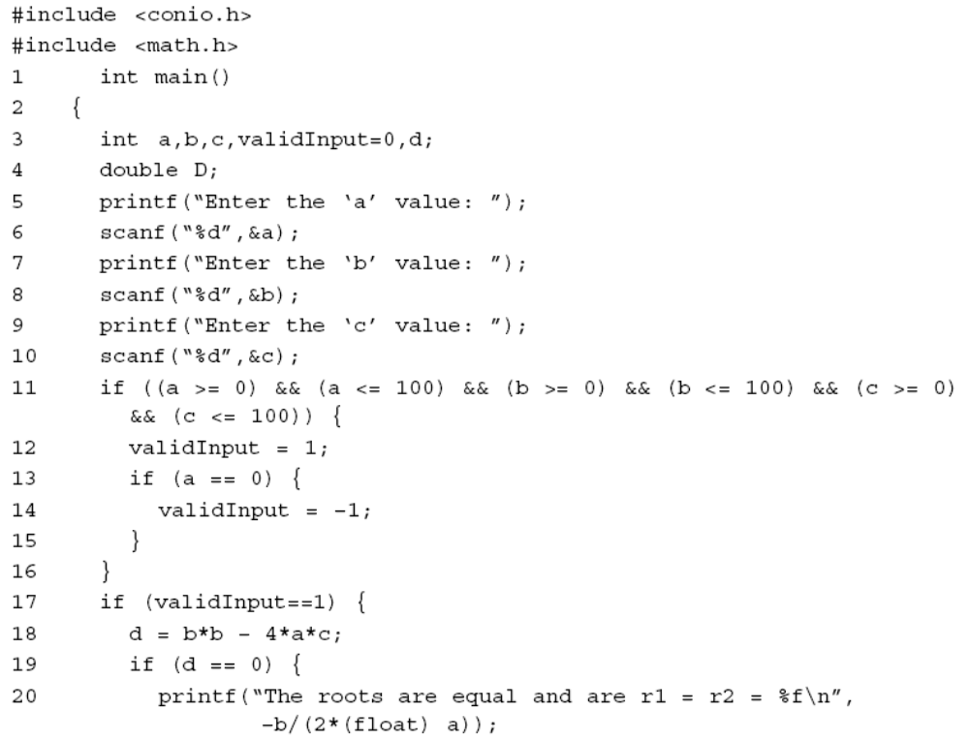
Software Testing
Notes:
Workshop on "How to find software faults before our customers find them" Copyright©2007

Slide 36
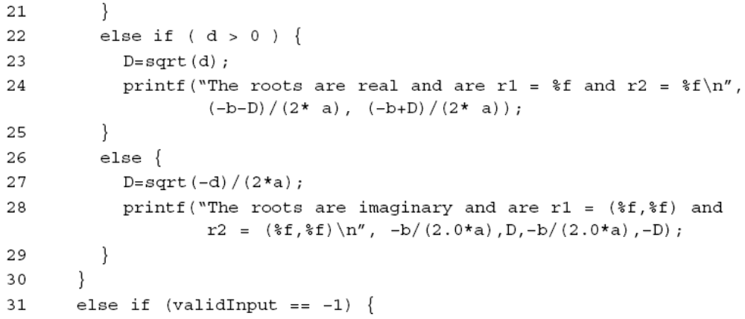
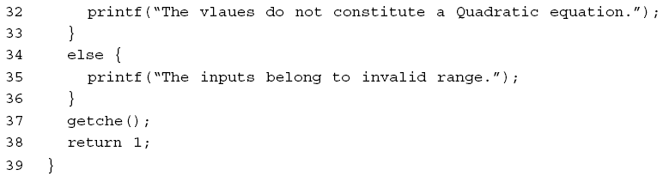
Software Testing
Code of quadratic equation problem
Notes:
Workshop on "How to find software faults before our customers find them" Copyright©2007

Slide 37
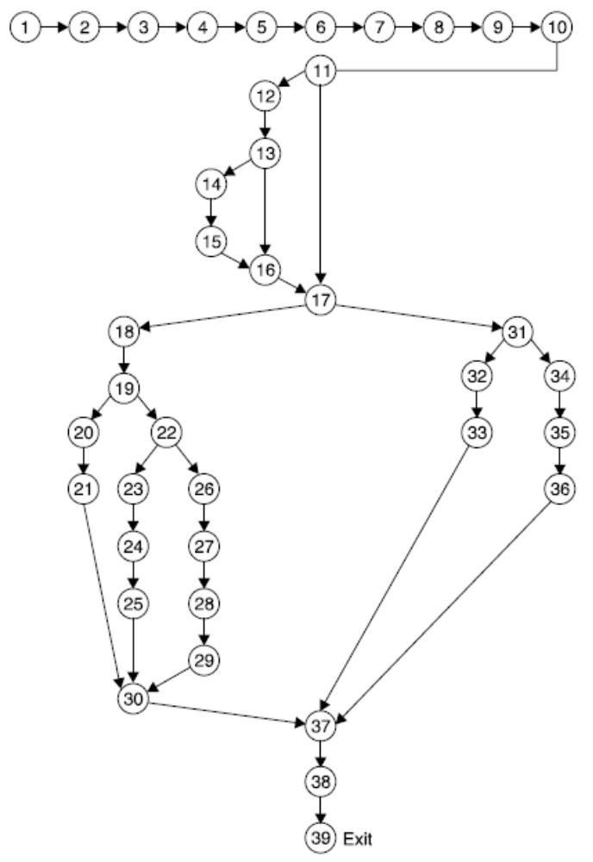
Software Testing
Solution 1:
Fig.17 (a): Program flow graph
Notes:
Workshop on "How to find software faults before our customers find them" Copyright©2007

Slide 38
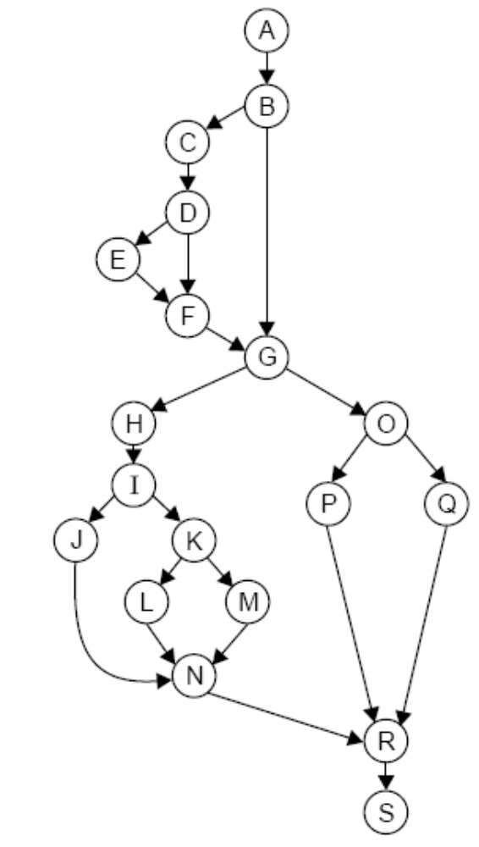
Software Testing
Fig. 17(b) : DD Path graph
Notes:
Workshop on "How to find software faults before our customers find them" Copyright©2007

Slide 39
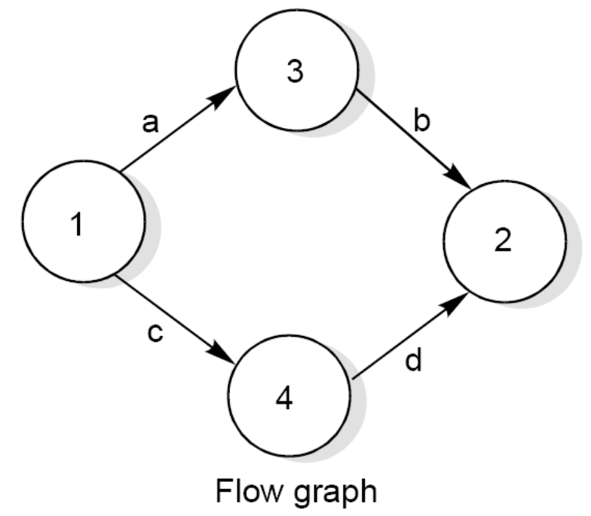
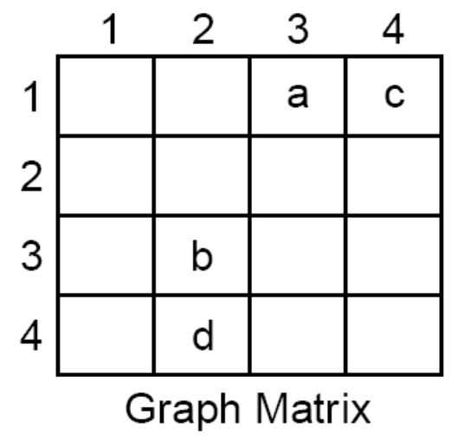


Graph Matrix
A graph matrix is a square matrix with one row and one column for every node in the graph. The size of the matrix (i.e., the number of rows and columns) is equal to the number of nodes in the flow graph. Some examples of graphs and associated matrices are shown in fig. below.
Flow graph and graph matrices

Slide 40
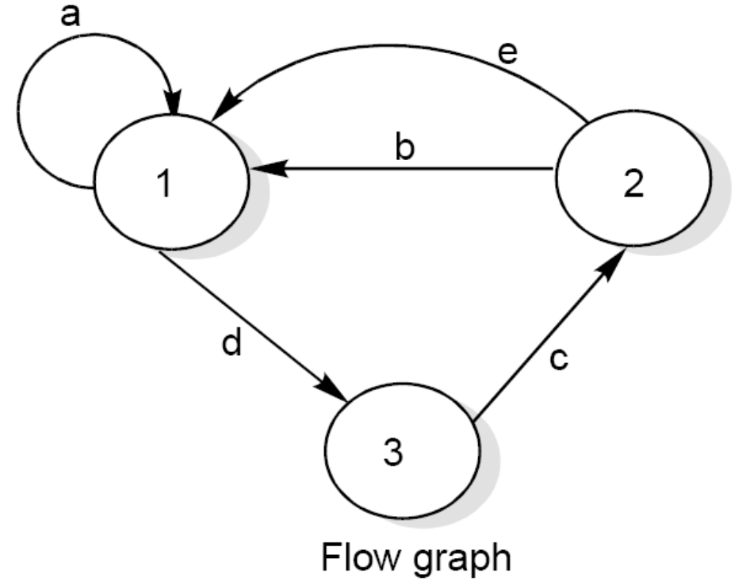
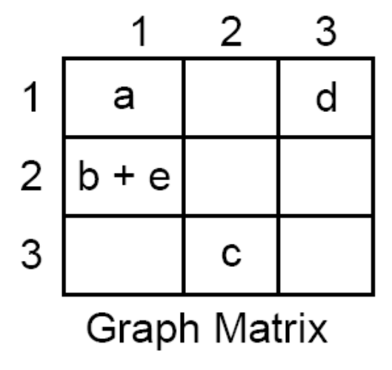

Graph Matrix
Flow graph and graph matrices

Slide 41
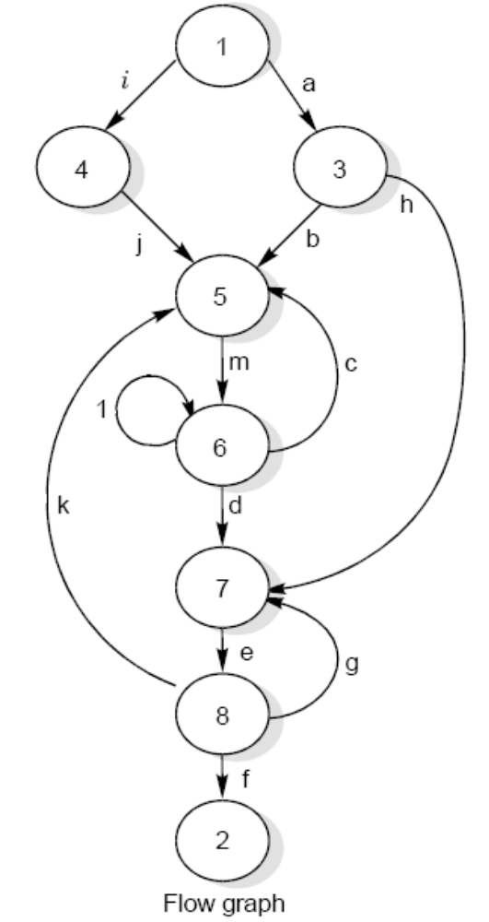
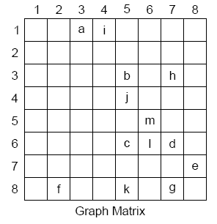

Graph Matrix
Fig. 24 (c): Flow graph and graph matrices

Slide 42
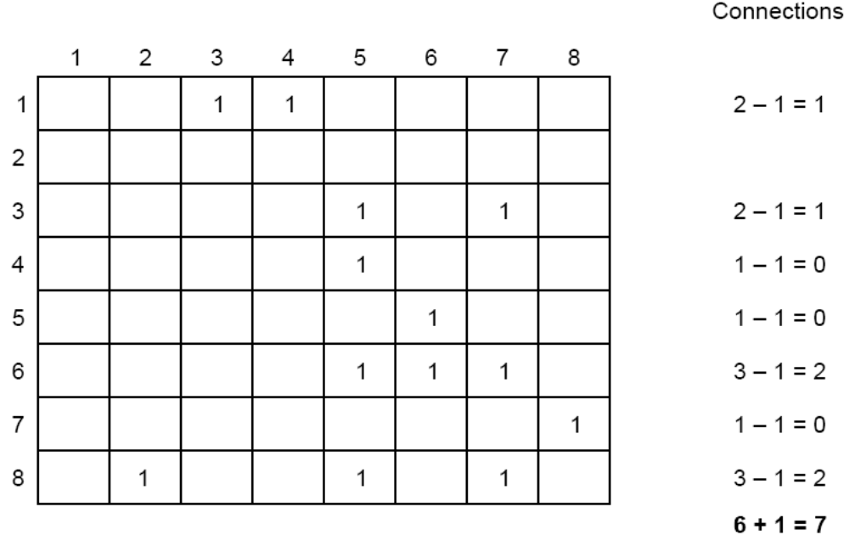
Graph Matrix
Fig. 25 : Connection matrix of flow graph shown in Fig. 24 (c)

Slide 43
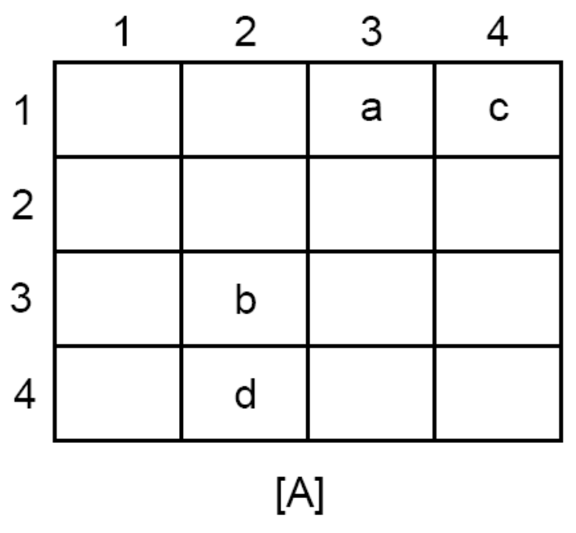
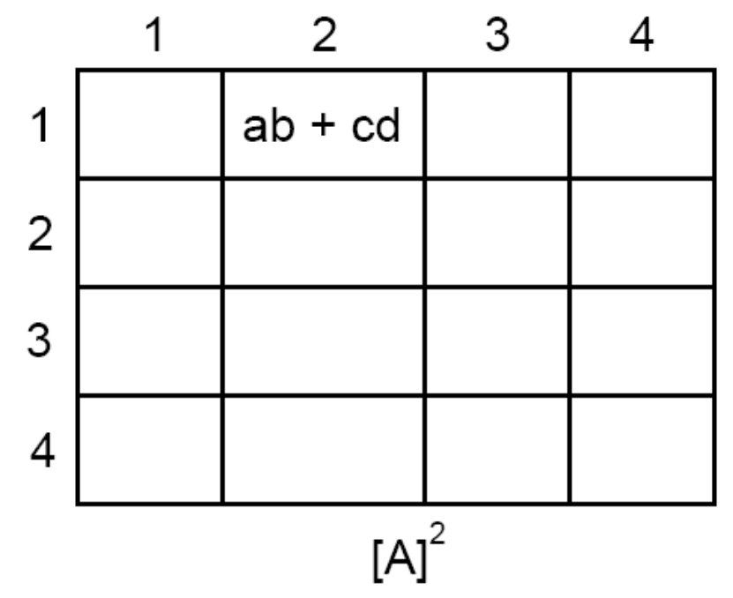
Graph Matrix
The square matrix represent that there are two path ab and cd from node 1 to node 2.

Slide 44
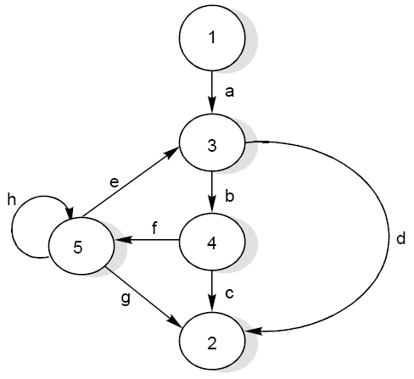
Graph Matrix
Consider the flow graph shown in the Fig. below and draw the graph & connection matrices. Find out cyclomatic complexity and two / three link paths from a node to any other node.
Flow graph

Slide 45
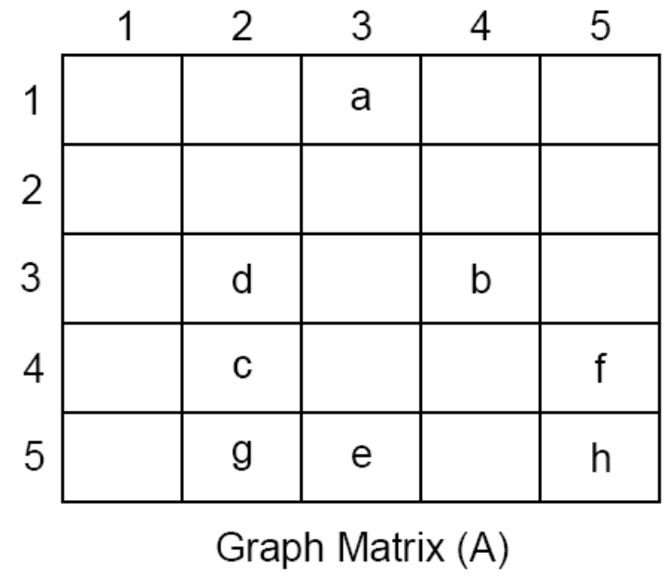
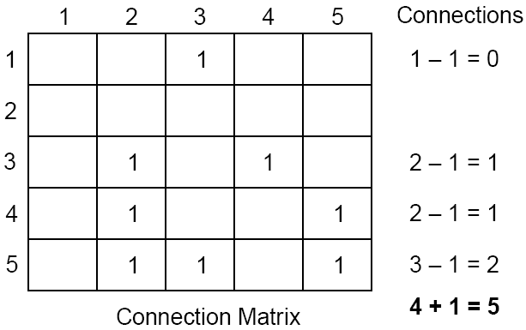
Graph Matrix
Solution
The graph & connection matrices are given below :
To find two link paths, we have to generate a square of graph matrix [A] and for three link paths, a cube of matrix [A] is required.

Slide 46
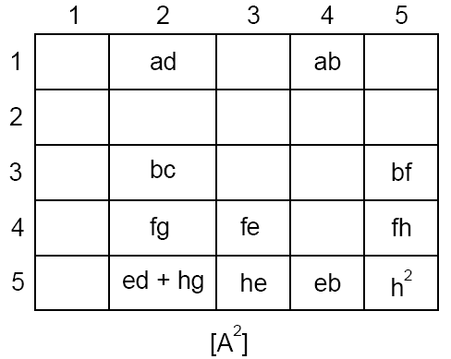
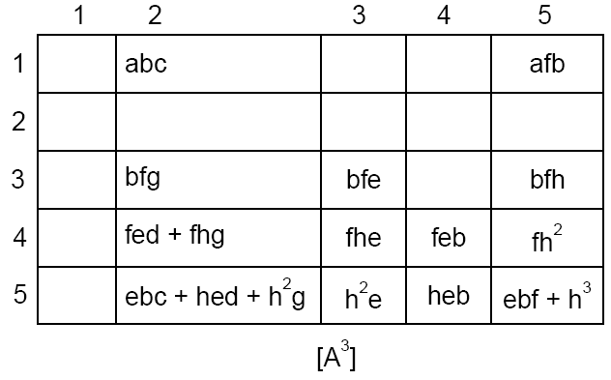
Graph Matrix

Slide 47
Practice
N1
N2
N3
N7
N4
N5
N8
N6
N9
N10
N11
DD Path Graph for program to find the largest of amongst three numbers
N12
N13

